Slide 1
MY FAMIMLY

Slide 2
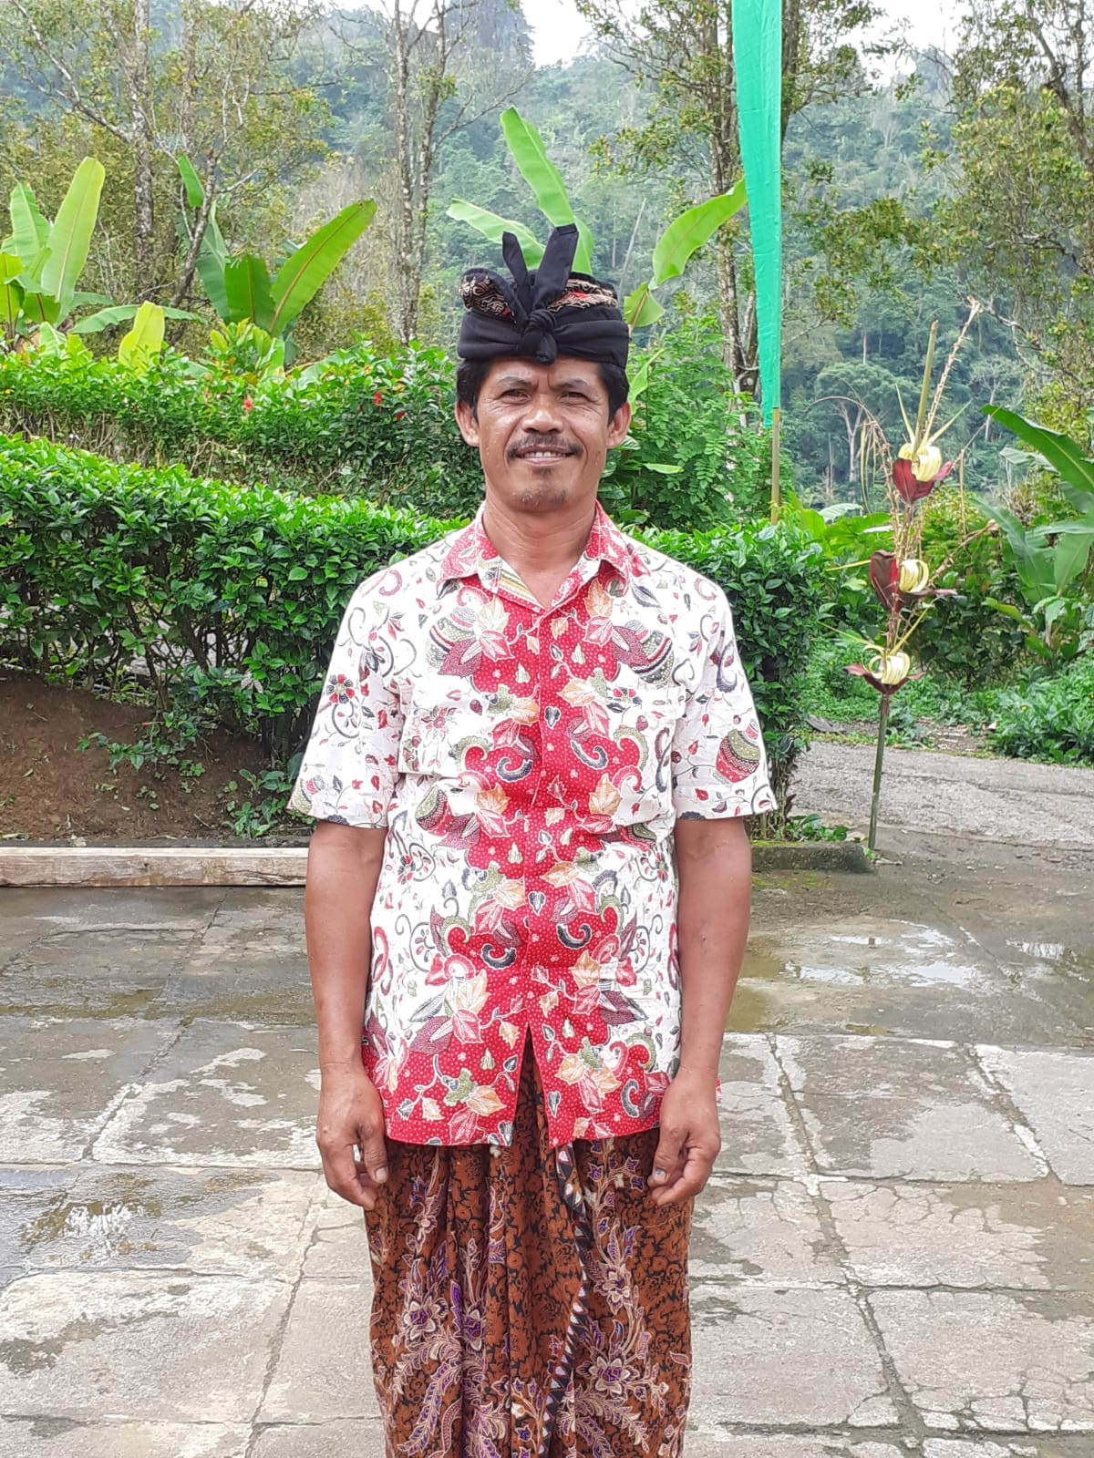
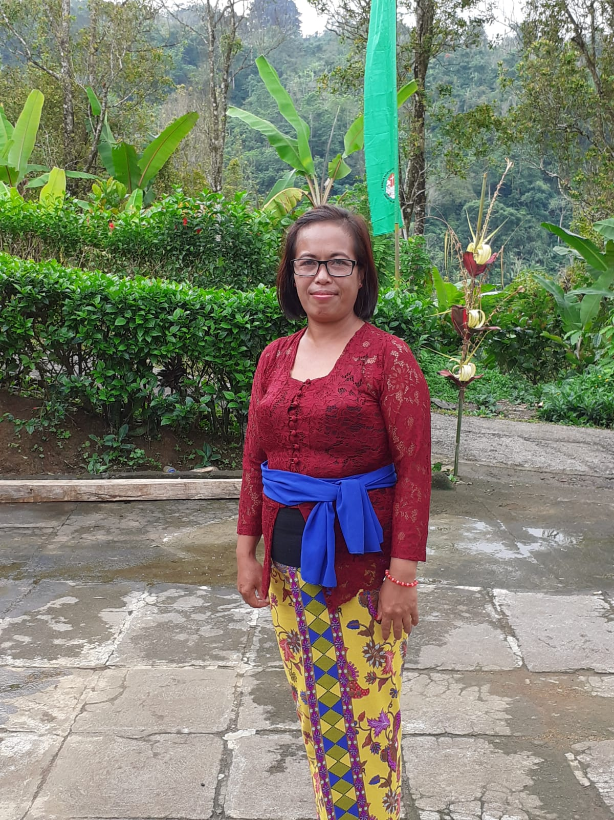
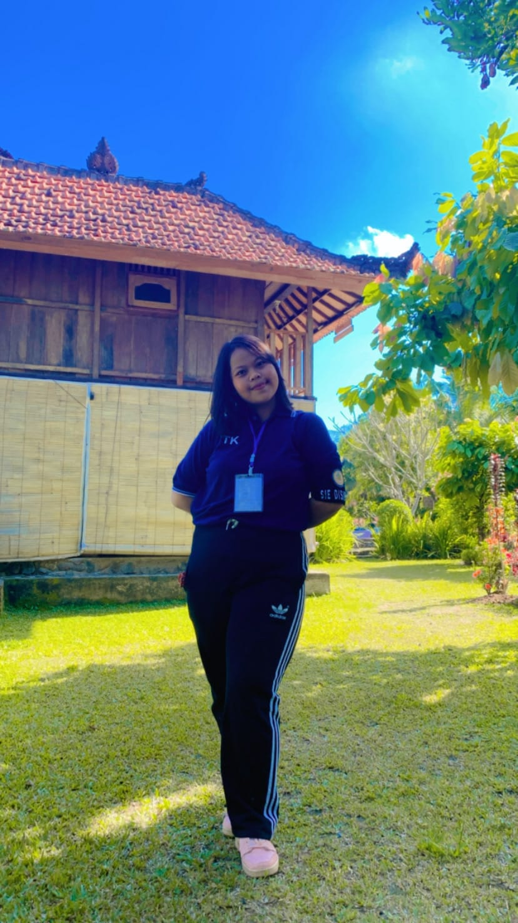

ABRAHAM FAMILY
DAD
MOM
ME
SISTER

